Slide 1
Why Do Parents Make Their Children Work? A Test of the Poverty Hypothesis in Rural Areas of Burkina Faso Author: Christelle Dumas
Lauren Coker

Slide 2
Motivation
Determine why child labor prevails in rural areas of Burkina Faso
Determinants of child labor supply:
Becker’s theory of education demand
Child labor may be the optimal response to a trade-off between returns to costs of education.
Impact of constraints on the household labor supply
Adult’s labor market imperfections, poverty, or credit imperfections can favor child labor.
Develop a poverty hypothesis that is valid for rural areas
Basu & Van: Child labor is due to parent’s poverty
Preferences of the parents towards child leisure. Children are sent to work if and only if their income is below the subsistence consumption threshold.
Above the subsistence level parents trade off between child leisure and household consumption.

Slide 3
Poverty Hypothesis
Subsistence Hypothesis
If true this suggests an easy way of eradicating child labor would be to redistribute income to poor households in order for them to reach the subsistence level.
Hypothesis assumes that household consumption must reach or exceed a subsistence threshold.
Must test whether the subsistence constraint is active and if it is the cause of child labor.
Luxury Hypothesis
Basu & Van explain that “children’s leisure or, more precisely, non-work is a luxury good in the household’s consumption in the sense that a poor household cannot afford to consume this good but it does so as soon as the household income rises sufficiently” (305).
In order to test the hypotheses there must be a specification for testing whether child leisure is a luxury or not.

Slide 4
Data
Burkina Faso Household Survey
International Crops Research Institute for Semi-Arid Tropics
Five year panel study (1981-1985)
150 households in 6 villages
3 different agro-climatic zones of Burkina Faso (Sahelian, Sudanian, Guinean)
Data collected by visiting the sampled households approximately every 10 days.
Limitations
Aggregates time labor by workers categories
Children younger than 10
Male and female adults over 10
Non-household workers
Unable to use the same age specifications as the ILO and distinguish by gender.

Slide 5
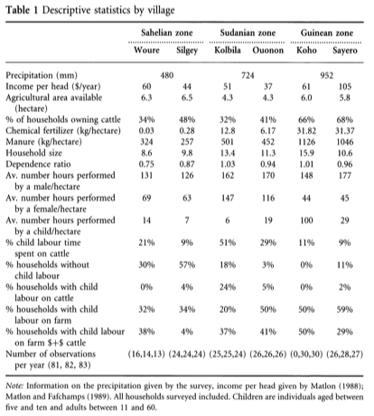
Data (cont.)

Slide 6

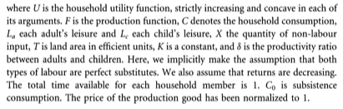
Market Imperfections and Labor Supply in Rural Households
Market Imperfections
Consider labor market imperfections as a potential cause of child labor.
Labor market in rural areas during the 80s were not competitive.
Number of non-household workers on the farm is low – less than 1/6 of total family labor.
100% of off-farm agricultural activities were done by someone belonging to the extended family.
Assume absence of labor and land markets.
Labor Supply
Given that there isn’t a labor market. The following assumptions apply:
Households farm their land with their own workforce and equalize their labor supply (as consumer) and their labor demand (as producer).
Households do not choose the quantity and quality of the land they own.
Households live only with the income generated by land farming.
General Case for Preference Maximization

Slide 7

Subsistence Hypothesis Test
Subsistence Constraint Not Binding
Subsistence Constraint Binding
Summary
Models provide a relationship between leisure demands and land.
Child and adult leisure increase with land if the subsistence constraint is binding.
If households are constrained by subsistence, then household labor supply must decrease with land.
Substitution effect is greater than the income effect and marginal productivity of labor becomes sufficiently high.

Slide 8

Luxury Hypothesis Test
Utility Function Specification
Child and Adult Leisure Trade-Off
Develop a utility function such that leisure could be either a normal good or a luxury good depending on parameter values.
Fail to reject the hypothesis that child leisure is a normal good.
The idea that households have strong preferences towards child leisure is not supported by the data.

Slide 9
Results
Correlation between child leisure demand and adult leisure demand provides evidence that there are unobservable preferences towards child leisure or unexplained differences in productivity ratios that affect both leisures in opposite directions.
Adult leisure is a decreasing function of land area so we can eliminate the hypothesis of a binding subsistence constraint.
Conclude from the luxury hypothesis test that households do not have strong preferences towards child leisure. This could be explained by the fact that child labor is also a way of accumulating specific human capital in an environment where schooling is not available.
Neither the subsistence nor the luxury hypotheses are confirmed. Child labor is more likely due to a deficient labor market than to poverty.
Critique
Provide an explanation of the differences in the three zones from the original survey
Dependency ratio – Both the Kolbila and Koho villages have high dependency ratios but different child labor levels

